Slide 1
Predictive Analytics on AMES Housing Data
Analysis into AMES Housing PROJECT

Slide 2
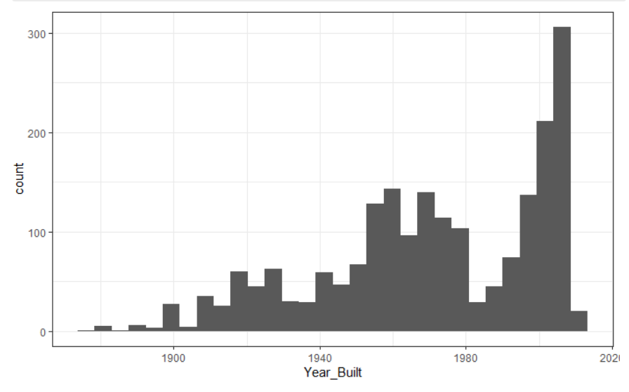
Data Synopsis
The data contains more than 2000 observations and 82 variables.
In total, 82 variables focus on the quality and quantity of many physical attributes of the property. Most of the variables are precisely the type of information that a typical home buyer would want to know about a potential property (e.g. When was it built? How big is the lot? How many square feet of living space is in the dwelling? Is the basement finished? How many bathrooms are there?).
Data set contained 24 nominal variables and 23 ordinal variables. Nominal Includes variables like-the weather condition and material used for construction. For the nominal and ordinal variables, the levels were in the range of 2 to 28. Total of 14 discrete variables comprises the number of kitchens, washrooms, and bedrooms. This also includes the garage capacity and construction or re-modelling dates; 20 continuous variables describe the area dimension of each observation. Lot size and total dwelling square footage are standard home listing available online. Area measurements on the basement, porches and main living area are further classified into respective classes based on quality and type.
Histogram of Year Homes were built in Ames
The distribution is bi-model, with a peak of newly built homes. The distribution is left skewed.

Slide 3
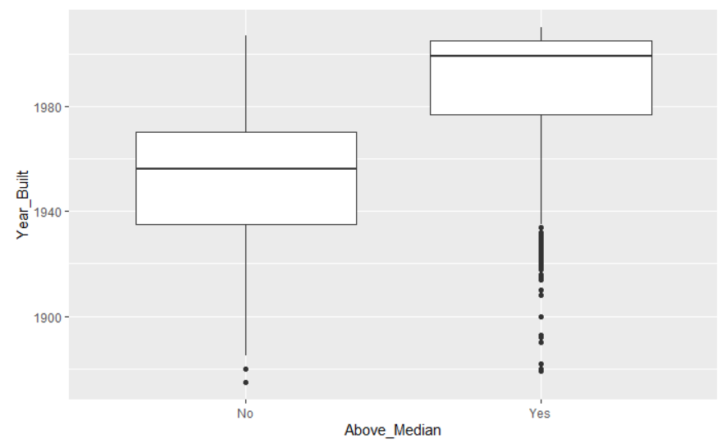
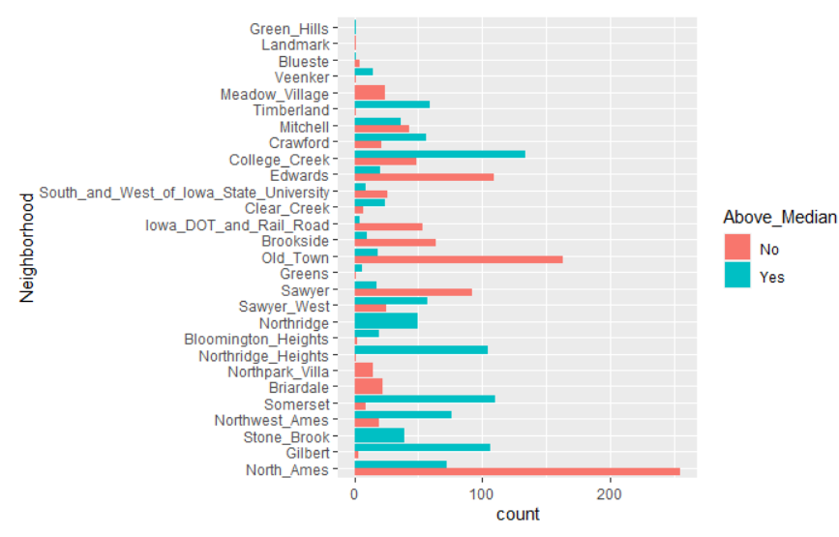
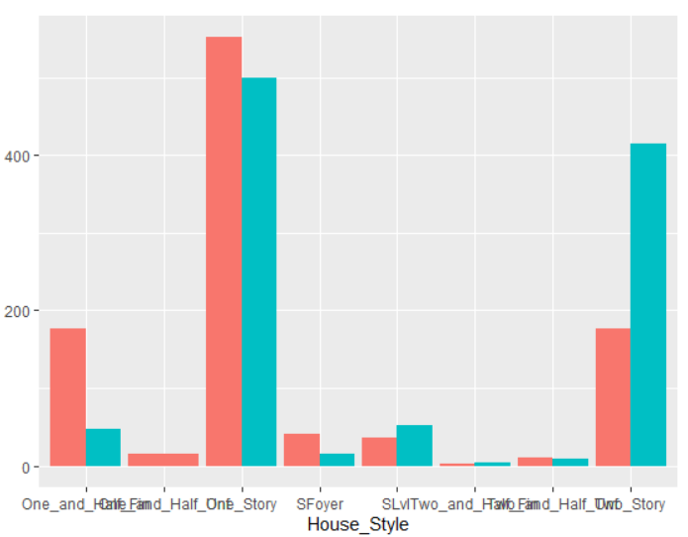
Home demographic analysis
AGE OF THE HOUSE
HOUSES BY NEIGHBORHOOD
HOUSE STYLE
Age of the house : One of the first things real estate agents, appraisers and prospective homebuyers look at is the historical sale prices of the property.
Data shows, housing price has a negative relationship with the age of the house.
Newer homes will sell for more because they typically require less maintenance.
Neighborhood is one of the biggest influencers of a home’s value. The quality of the school system, other home prices and crime rates impact the neighborhood’s values.
Data shows -- College_Creek, Somerset, Gilbert , Northridge Heights are above the median price.
Below median prices - North_Ames, Oldtown, Edwards, Sawyer, Brookside are below the Median price.
Sawyer, Mitchell, Crawford are in-between.
Style of home: Whether a two story or one story, the style of the home matters. In addition to age, comps should be a similar style. That’s because changing real estate trends affect popular home styles -- and trendy houses fetch higher prices.

Slide 4
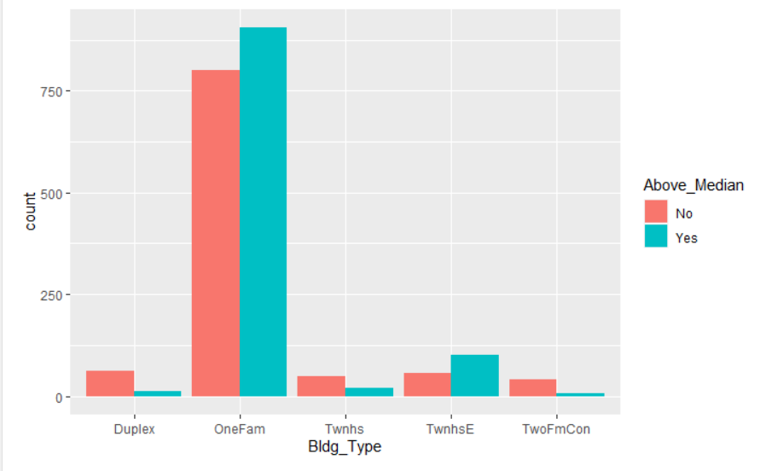
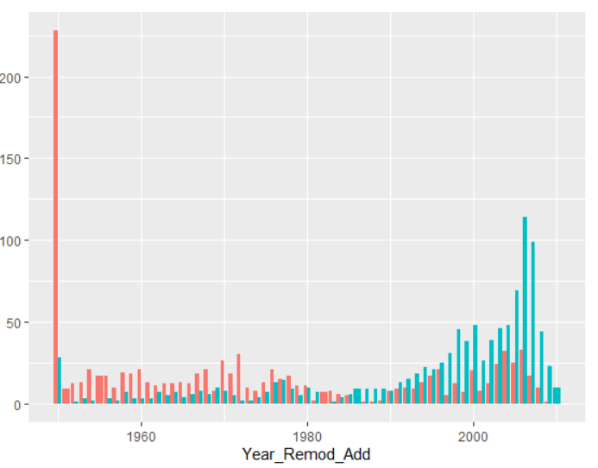
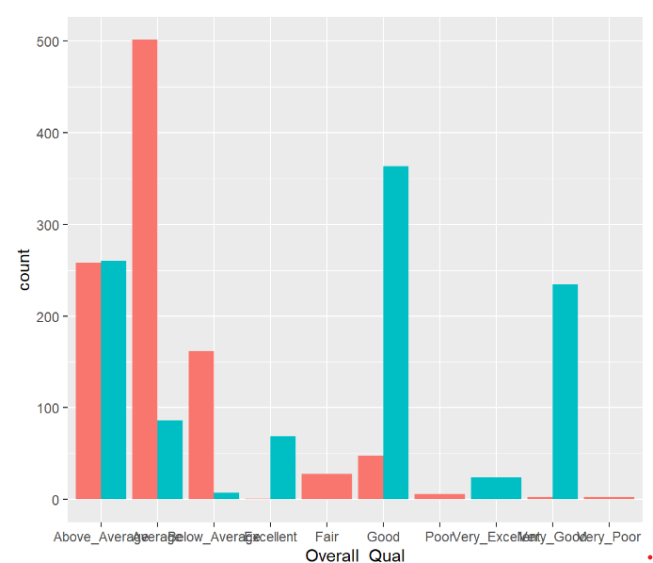
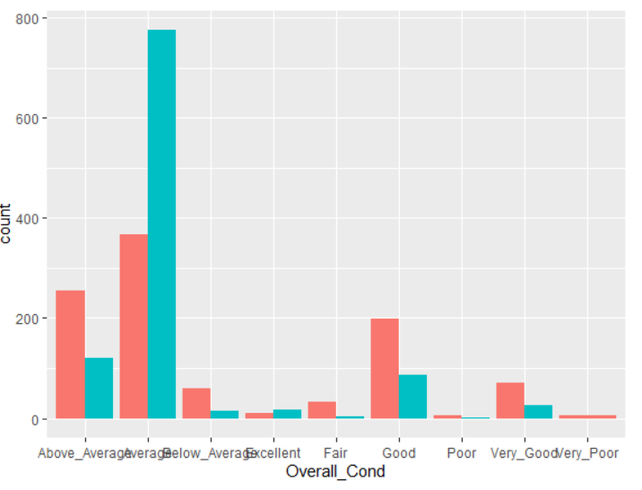
INFLUENTIAL FACTORS DRIVING HOME VALUE
BUILDING TYPE
YR REMODEL
Building elements like the structure, walls, floors, and roof are all telling of a building’s class.
Top renovation, remodeling, and home improvement projects increase home values based on market data on thousands of recent home sales.
Overall Quality and condition of the home drives the home value. Newer homes will sell for more because they typically require less maintenance. Condition also matters. A well-maintained older home can sell for just as much .
Typically, homes that are newer appraise at a higher value. The fact that critical parts of the house, like plumbing, electrical, the roof, and appliances are newer and therefore less likely to break down, can generate savings for a buyer.
Things like the home’s foundation, structural integrity, electrical work, plumbing and fixtures are all worth considering.
Overall condition and quality drives the home value.
OVERALL QUALITY
OVERALL CONDITION

Slide 5
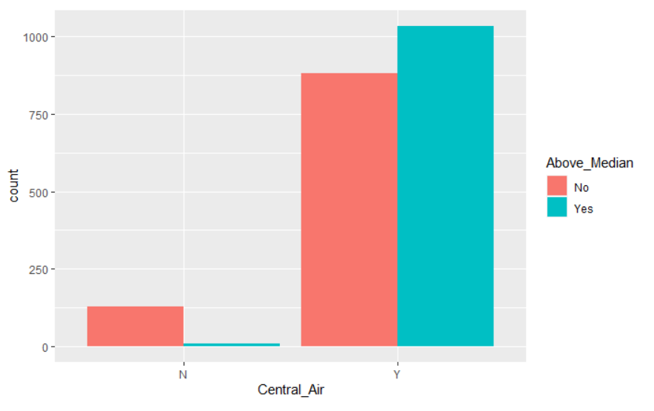
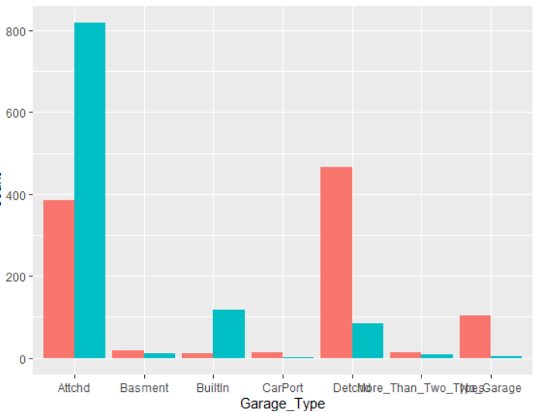
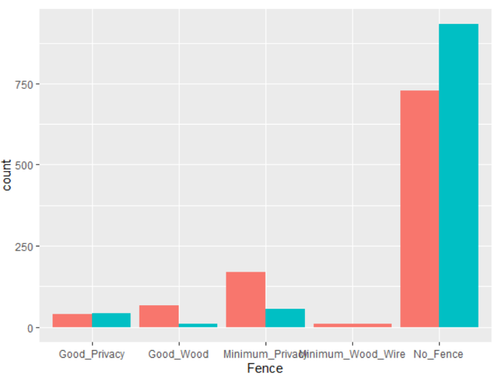
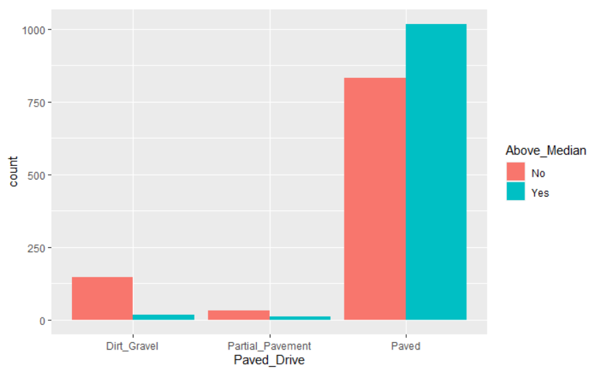
Comfort Considerations
CENTRAL AIR
GARAGE TYPE
A central air conditioning may significantly improve your home's comfort, especially during the hot summer. Rather than having several window air conditioning units throughout your house, you can have a single central unit that feeds conditioned air through the various vents. When it comes to air conditioner maintenance, you’ll only have to worry about cleaning a single unit.
Another factor is the finished or attached garage . A garage is a key part of many homes. Providing storage space for cars, gardening supplies, tools, sports equipment, bikes and more, the right garage can be an essential part of a home.
Having a fence that doesn’t match the home’s style may be worse than having no fence at all. Neighborhood HoA CCR does regulate the aesthetic guidelines to keep it consistent. As per the data, homes with no fence seem to fetch higher value and sells more.
Entering homes is another important factor home buyers consider, and paved driveway seem to be yielding higher home price than those with dirt & gravel. As the entrance way to your home, a driveway acts as the focal the facial point of the property. Paving anew driveway can add significant value to your property. You can get a great return on your investment. At the very least your property value increase will cover the cost of the driveway.
FENCE
PAVED DRIVE

Slide 6
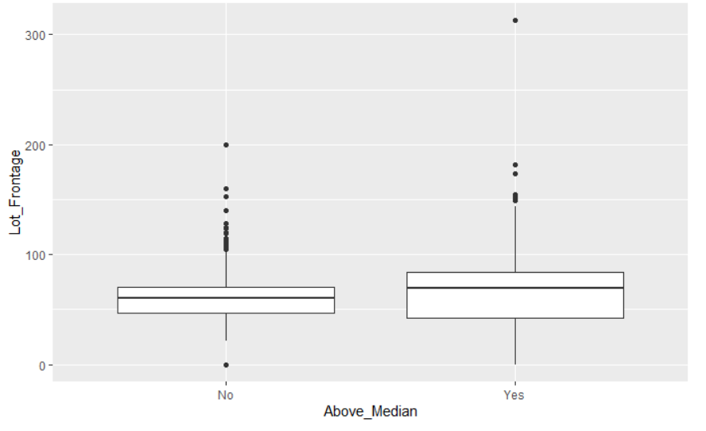
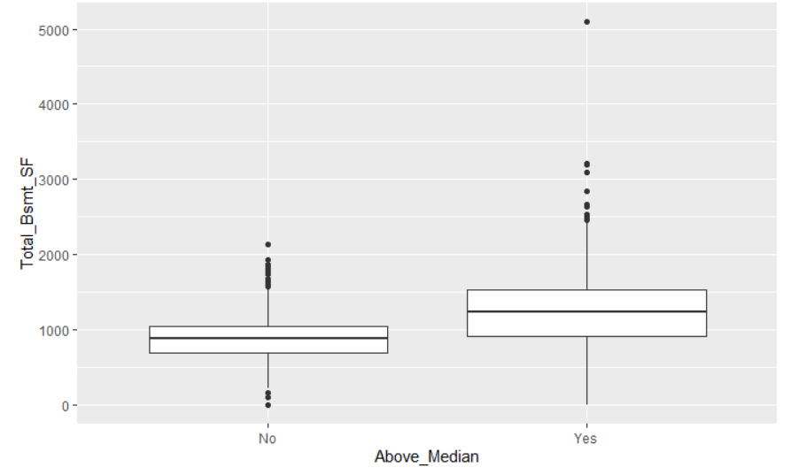
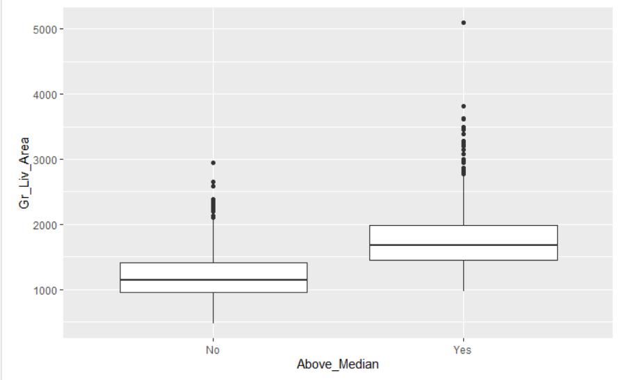
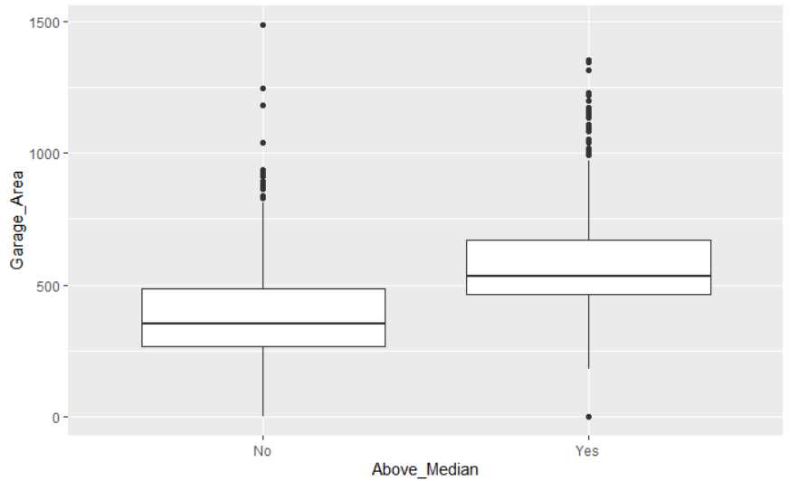
Home size and usable space
LOT FRONTAGE
TOTAL BASEMENT
When estimating your home’s market value, size is an important factor to consider, as bigger home can positively impact its valuation in terms of price.
The value of the home is estimated in price per square foot. The price buyers will pay per square foot can vary greatly based on the lot size both usable space (living space) and storage space.
Garages, attics, and unfinished basements are generally not counted in usable (living) square footage.
While livable space is considered most important to buyers and appraisers. Bedrooms and bathrooms are most highly valued, so the more beds and baths your home offers, the more your home is generally worth. However, these trends are very locally specific and as per the data garage area, finished basement does seem to impact home value positively or higher.

Slide 7
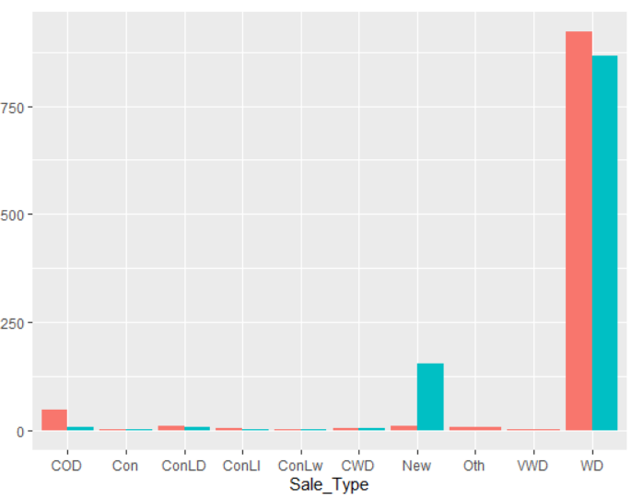
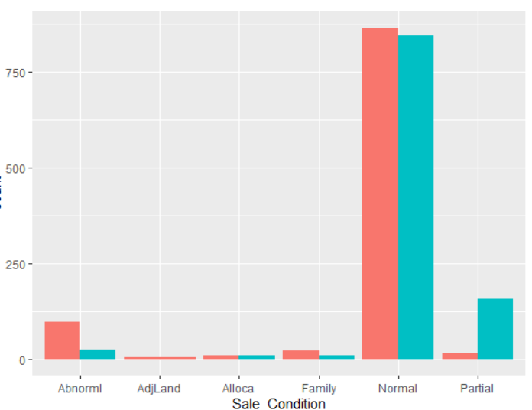
OTHER key factors impacting median price

